Slide 1

DATA - BUSINESS PORTFOLIO
EMPLOYEE ATTRITION
PREDICTION & STRATEGY
BY THABEEB JAFRAN | 2023

Slide 2
EMPLOYEE ATTRITION
PREDICTION & STRATEGY
2023
BUSINESS BACKGROUND & SCOPE
01 / THE BACKGROUND
IBM, known as 'The Big Blue,' is a major multinational technology corporation headquartered in New York, USA, specializing in software and hardware.
Established in 1911, IBM faced a challenging year in 2022 due to a high employee attrition rate in the US.
02 / PROJECT OBJECTIVE
Analyzing & Strategizing for 2023
Now, we’ll analyze to find strategy of the attrition to prediction to reduce attrition in 2023 using the IBM 20222 Employee Attrition Rate dataset.

Slide 3
EXECUTIVE SUMMARY
EMPLOYEE ATTRITION
PREDICTION & STRATEGY
2023
01 / PROJECT BACKGROUND
In 2022, IBM Employee Attrition rate is considered High (16.14%).
Overtime, Salary, and Stock Option Level are the most correlated variables.
Goal: Reduce attrition to below 10% by strategizing prediction models through 2023.
03 / IMPACT ANALYSIS
New attrition strategy predicts a rate decrease of 3.41% (from 12.2% to 8.79%).
Predicted churned employees working overtime decrease by 28.3%.
Churn with no stock options decreases by 55.1%, and low stock options by 2.94%.
Churn for salary <$5K decreases by 15%, and for $5K-$10K decreases by 56.2%.
02 / LINEAR REGRESSION ANALYSIS
Based on prediction, 148 Employees are predicted to leave the company in 2023.
100% of the predicted churned employees work overtime.
Most predicted churned employees have a monthly salary less than $5,000.
Most predicted churned employees do not receive any stock options.
04 / INSIGHT & RECOMMENDATION
Discover tailored strategic frameworks and specific mitigation actions designed to resolve key drivers in the subsequent sections.
SEE DETAILED INSIGHTS IN SECTIONS 05 & 06
3

Slide 4
EMPLOYEE ATTRITION
PREDICTION & STRATEGY
2023
01
SECTION 01
PROJECT BACKGROUND
Understanding Attrition Patterns & Predictive Insights

Slide 5
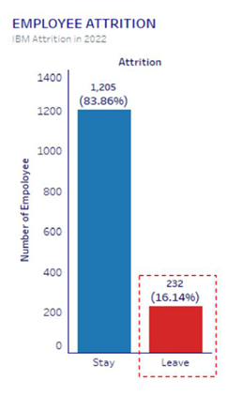
In 2022, IBM Employee Attrition Rate is considered High (16.14%)
EMPLOYEE ATTRITION
PREDICTION & STRATEGY
2023
01 / ATTRITION BREAKDOWN
02 / KEY ATTRITION METRICS
232
Employees Left the Company in 2022
Out of a total of 1,437 employees in the US, 232 departed, creating a critical high-attrition baseline.
Strategic Focus for 2023
We must aggressively focus on reducing the attrition rate in 2023 by addressing core drivers such as overtime workloads and optimized compensation structures.

Slide 6
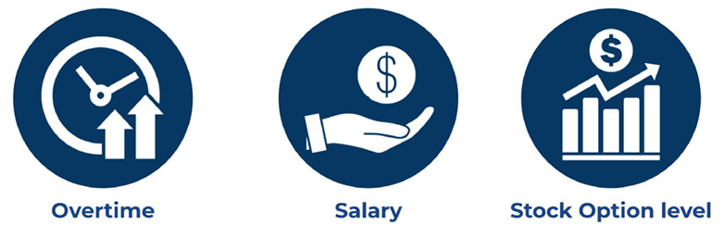
Key Drivers of Employee Attrition
EMPLOYEE ATTRITION
PREDICTION & STRATEGY
2023
01 / CORRELATION ANALYSIS
02 / PRIMARY ATTRITION DRIVERS
Overtime, Salary, and Stock Option Level
These three key organizational variables exhibit the strongest statistical correlation with employee attrition rates across all analyzed demographics.
Strategic Focus
We can dig down the prediction and strategize the attrition rate by focusing on these most related variables to build targeted retention programs.

Slide 7
Key Drivers of Employee Attrition
EMPLOYEE ATTRITION
PREDICTION & STRATEGY
2023
alarm
payments
pie_chart
53.4%
69.3%
65%
Worked Overtime
of employees who left the company in 2022 worked overtime.
Salary Under $5,000
of employees who left the company in 2022 had a monthly salary less than $5,000.
No Stock Options
of employees who left the company in 2022 had not received stock options yet.

Slide 8
PROBLEM STATEMENT
EMPLOYEE ATTRITION
PREDICTION & STRATEGY
2023
THE CORE CHALLENGE
How to reduce the IBM employee attrition rate to below 10% by strategizing the attrition prediction until the end of 2023?
trending_down
TARGET GOAL
< 10%
Employee Attrition Rate by End of 2023

Slide 9
ISSUE TREE: DECISION FRAMEWORK
EMPLOYEE ATTRITION
PREDICTION & STRATEGY
2023
2022 CURRENT STATE
Attrition Rate is High
16.14%
KEY DRIVERS OF 2022 ATTRITION
53.4%
Worked Overtime
69.3%
Salary Under $5,000
65.0%
No Stock Options
PATH A: PREDICTION
Analyze 2022 Attrition Data
Establish baseline metrics to accurately predict the employee attrition rate of 2023.
PATH B: STRATEGY & MITIGATION
Formulate Targeted Interventions
Design strategic programs specifically addressing overtime, compensation, and stock benefits to minimize future attrition.
KEY INQUIRY 1
What is the predicted IBM attrition rate for 2023?
Quantifying the baseline trajectory using logistic regression modeling.
KEY INQUIRY 2
What strategies can we plan to reduce 2023 attrition?
Developing targeted policies around overtime policies and compensation structures.
KEY INQUIRY 3
How much can our strategies reduce the predicted rate?
Performing impact analysis to project reduction percentages against target goals.

Slide 10
METHODOLOGY
EMPLOYEE ATTRITION
PREDICTION & STRATEGY
2023
01
Defining Business Problem
Background, problem statement, and objective
02
Data Preparation & Cleaning
Gather the data and cleaning using Python (missing values, duplicates, unused data, etc.)
03
Exploratory Data Analysis
Explore the data and gather deep structural insights and information
04
Data Analysis
Analyze using Logistic Regression, predict attrition rates, evaluate corporate strategies, and perform impact analysis
05
Data Visualization
Visualize data with dynamic charts and dashboards to communicate findings in presentation format
06
Insight & Recommendation
Address insights and deliver tactical recommendations generated from the comprehensive analysis
10

Slide 11

02
Section 02
ANALYSIS & EVALUATION
LOGISTIC REGRESSION

Slide 12
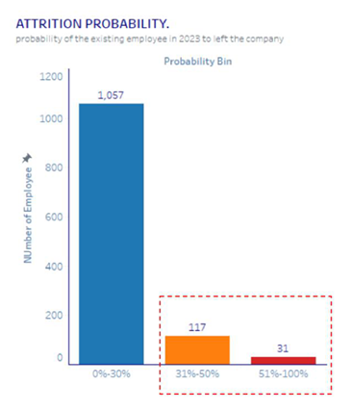
Based on prediction, 148 Employees (12.2%) are predicted to leave the company in 2023
EMPLOYEE ATTRITION
PREDICTION & STRATEGY
2023
Model Basis
The prediction model is based on Logistic Regression analysis of the 2022 attrition rate data.
Out of 1,205 employees in 2023:
31
High Risk (51% - 100% chance of leaving)
Employees exhibit a strong tendency to leave and require immediate mitigation.
117
Medium Risk (31% - 50% chance of leaving)
Employees demonstrate early signals of potential attrition.
1,057
Low Risk / Stable (0% - 30% chance of leaving)
Employees with a strong, predictable tendency to remain with the company.
12

Slide 13
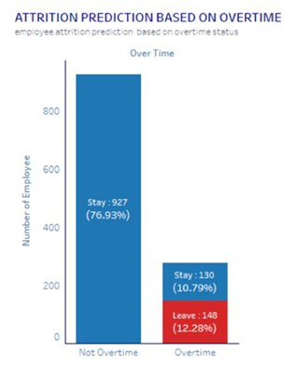
Based on prediction, all predicted churned employees in 2023 work overtime
EMPLOYEE ATTRITION
PREDICTION & STRATEGY
2023
Overtime Status Analysis
Analysis of 1,205 employees in 2023 shows strong correlation with overtime.
Key Metrics:
148
Overtime & Predicted to Leave (12.28%)
Represents 100% of all predicted churned employees. Urgent mitigation needed.
130
Overtime & Predicted to Stay (10.79%)
Employees currently staying but working overtime under high burnout risk.
927
Non-Overtime & Predicted to Stay (76.93%)
Stable employee group with zero predicted attrition.
Strategic recommendation: Limit overtime to lower job levels and urgent situations only.
13

Slide 14
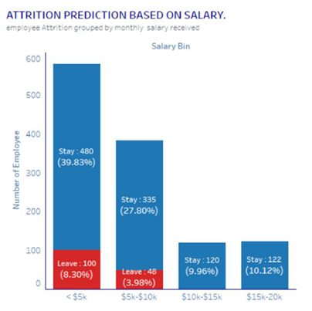
Based on prediction, most predicted churned employees in 2023 have salary less than $5,000
EMPLOYEE ATTRITION
PREDICTION & STRATEGY
2023
Salary Bin Analysis
Regarding the 148 predicted churned employees:
100
Earn < $5,000 / month (67.6%)
The vast majority of predicted attrition is concentrated in this lowest salary tier.
48
Earn $5,000 - $10,000 / month (32.4%)
Moderate attrition risk. Middle-income bracket showing lower overall vulnerability.
0
Earn > $10,000 / month (0.0%)
Zero predicted attrition for high earners, demonstrating strong organizational stability.
Strategic recommendation: Mitigate risk by optimizing entry-level compensation based on performance, job involvement, and clear promotional pathways.
14

Slide 15
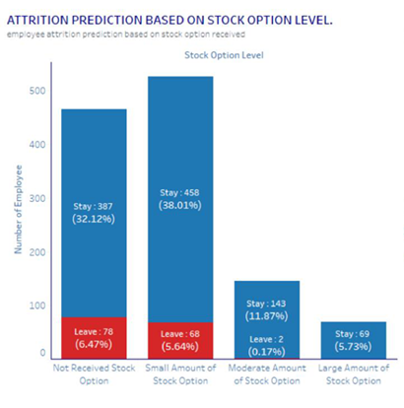
Based on prediction, most predicted churned employees in 2023 did not receive stock options
EMPLOYEE ATTRITION
PREDICTION & STRATEGY
2023
Stock Option Level Analysis
Regarding the 148 predicted churned employees:
78
No Stock Options (52.7%)
The absolute majority of predicted churned employees received no stock options.
68
Small Amount (45.9%)
High churn risk also persists for employees with only a small stock option level.
2
Moderate / Large Amount (1.4%)
Extremely low attrition among employees with moderate or large stock option levels.
Strategic recommendation: Mitigate risk by fairly granting stock options based on performance, loyalty, and job involvement.
15

Slide 16

Employee Attrition Prediction & Strategy
03
Impact Analysis
Evaluating the projected organizational outcomes, retention improvements, and strategic business benefits.
16

Slide 17
Strategy of Attrition Prediction
New strategy model to help decrease the attrition rate in IBM US
EMPLOYEE ATTRITION
PREDICTION & STRATEGY
2023
VARIABLE
Overtime
Job Level Restriction: Only applied in job level 1 and 2.
Urgent Condition: Applied under urgent conditions only.
VARIABLE
Salary
Performance-Based Increase:
Performance 1 (worst) = 2% Performance 2 = 3% | Performance 3 = 4% Performance 4 (best) = 5%
Job Involvement Increase:
Involvement 1 (worst) = 2% Involvement 2 = 3% | Involvement 3 = 4% Involvement 4 (best) = 5%
Promotion Criteria (+15%):
Performance 4 + Job Involvement 3-4 + Min. 1 Training attended.
VARIABLE
Stock Option
Stock Option Level Parameters:
Performance 4: +1 level
Job Involvement 4: +1 level
Work Over 5 Years: +1 level
7

Slide 18
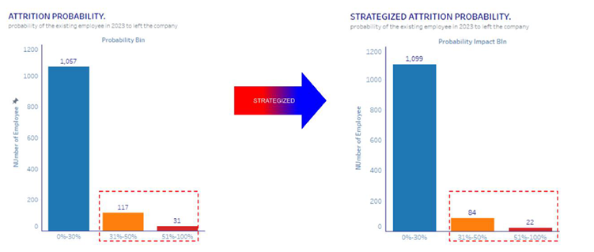
Overall Attrition Reduction
With new strategy, overall predicted attrition rate decreases by 3.41% (from 12.2% to 8.79%)
EMPLOYEE ATTRITION
PREDICTION & STRATEGY
2023
METRICS SUMMARY
Strategy Impact
Number of predicted churned employees based on overall probability:
30% - 50% Chance of Leaving: Decreased from 117 to 84
51% - 100% Chance of Leaving: Decreased from 31 to 22
8

Slide 19
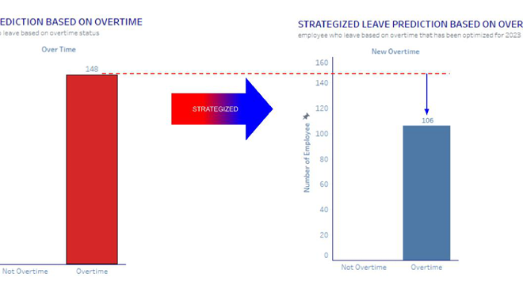
Overtime Attrition Reduction
With the new attrition strategy, predicted churned employees who work overtime decreased by 28.3%
EMPLOYEE ATTRITION
PREDICTION & STRATEGY
2023
METRICS SUMMARY
Strategy Impact
Significant reduction in overtime-related employee churn:
Overtime Churn Volume: Decreased from 148 to 106
Proportional Decrease: -28.3% Attrition Drop
19

Slide 20
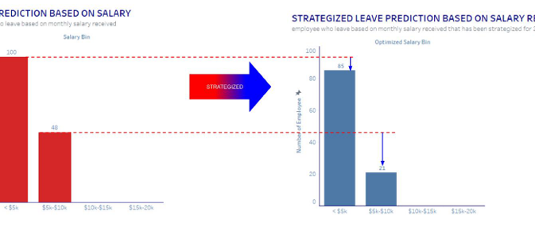
Salary Attrition Reduction
With the new attrition strategy, predicted churned employees with low-to-medium salaries saw significant decreases
EMPLOYEE ATTRITION
PREDICTION & STRATEGY
2023
METRICS SUMMARY
Strategy Impact
Significant drop in churn volume across key salary brackets:
Salary Under $5K: Decreased by 15.0% (from 100 to 85)
Salary $5K - $10K: Decreased by 56.2% (from 48 to 21)
Overtime Churn: Decreased from 148 to 106
20

Slide 21
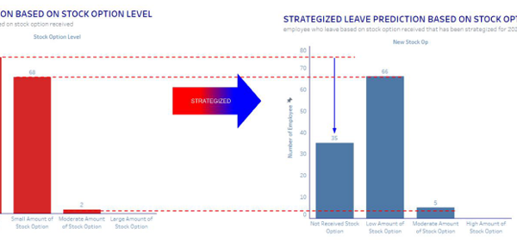
Stock Option Attrition Reduction
With the new attrition strategy, predicted churned employees with no stock option decreased by 55.1%
EMPLOYEE ATTRITION
PREDICTION & STRATEGY
2023
METRICS SUMMARY
Strategy Impact
Significant drop in churn volume across stock option levels:
No Stock Option: Decreased by 55.1%
Low Stock Option: Decreased by 2.94%
Moderate Stock Option: Slight increase (minimal overall impact)
21

Slide 22

Part 04
Insight and Recommendation

Slide 23
Attrition Insights & Analytics
Key drivers, predictive insights, and targeted strategies for 2023
EMPLOYEE ATTRITION
PREDICTION & STRATEGY
2023
01. KEY DRIVERS
Primary Variables
Overtime, Salary, and Stock Option Level are the most critical variables for strategizing. These factors hold the highest correlation with employee attrition at IBM, serving as the foundation of our predictive models.
03. PREDICTIVE FORECAST
2023 Baseline Attrition Risk
12.2% PREDICTED ATTRITIONOverall Baseline Risk The projected attrition rate for 2023 if no tactical mitigation strategy is implemented.
100% Work Overtime of predicted churns67.5% Salary < $5,000 of predicted churns52.7% No Stock Options of predicted churns
02. ACTION PLAN
Mitigation Strategy
•Limit Overtime Hours Directly address and reduce the heavy workload of employees who systematically log overtime.
•Fairly Increase Salaries Conduct market adjustments to elevate compensation bands, focusing on key roles under the $5,000 threshold.
•Distribute Stock Options Equitably Expand the stock option eligibility criteria to build long-term retention and ownership among staff.
04. TARGET IMPACT
Projected Strategy Outcomes
-3.41% Attrition Reduction8.79% Target Attrition Rate
23

Slide 24
Business Recommendations
Strategic action plans for organizational stability and attrition mitigation
EMPLOYEE ATTRITION
PREDICTION & STRATEGY
2023
01. CHIEF OPERATING OFFICER
Establish Strategic Guidelines
Adopt the analyzed strategy as the primary organizational guideline for executive planning.
8.79%
TARGET ATTRITION RATE
Proven in rigorous impact analysis to keep employee retention within optimal bounds.
02. HUMAN RESOURCES TEAM
Monitor Promotion & Training
Develop strong pathways for upward mobility to secure talent pipeline continuity.
Track Promotion Eligibility Assess candidates proactively using standard performance and job involvement metrics.
Targeted Career Training Facilitate specialized programs to elevate critical internal skills and boost long-term commitment.
03. MANAGERS & LEADERS
Objectivity & Overtime Control
Ensure a balanced workplace by reducing subjective reviews and workload fatigue.
Standardize Appraisals Keep ratings highly objective by strictly tying them to direct performance and job metrics.
Manage Overtime Hours Closely monitor team workload and fatigue limits to maintain operational effectiveness.
24

Slide 25
EMPLOYEE ATTRITION
PREDICTION & STRATEGY
2023
Appendices
Dataset sources, analysis notebooks, and interactive visualizations
25

Slide 26
Dataset & Analysis Process
Direct links to the raw data sources, python modeling environments, and production dashboards
EMPLOYEE ATTRITION
PREDICTION & STRATEGY
2023
01. SOURCE DATA
Kiggle Attrition Dataset
Explore the foundational IBM HR Analytics dataset used for training models and extracting key attrition drivers.
Dataset from Kaggle →
02. PROCESSING & MODELING
Google Colab Python
Run the Python notebook to review the pipeline: data preprocessing, exploratory analysis, and machine learning models.
Google Colab Notebook →
03. INTERACTIVE VISUALS
Tableau Dashboard
Access interactive dashboards to analyze metrics dynamically, filtering by department, overtime, and salary bins.
Tableau (Dashboard) →
26

Slide 27
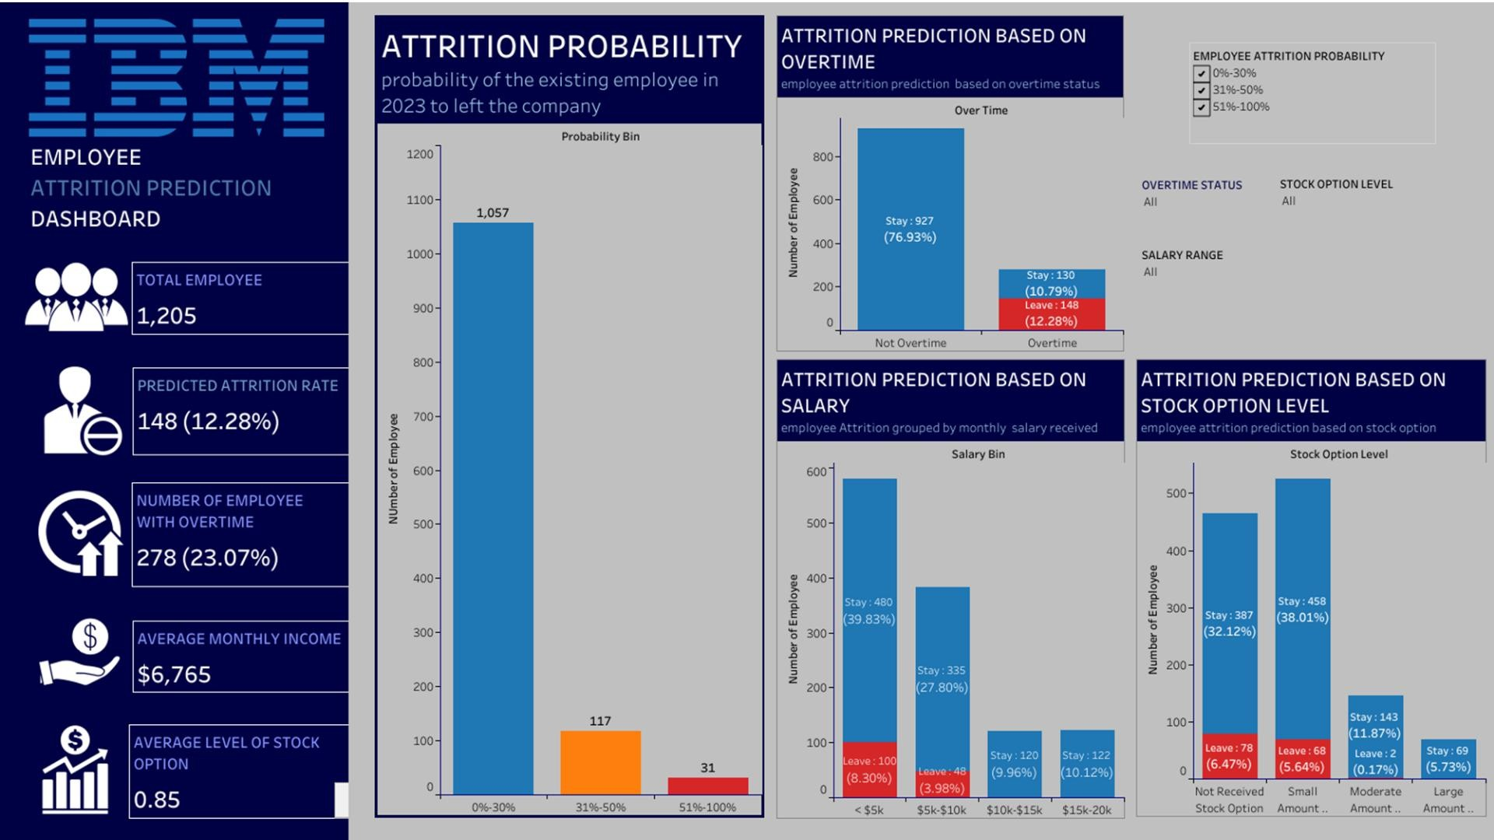

Slide 28
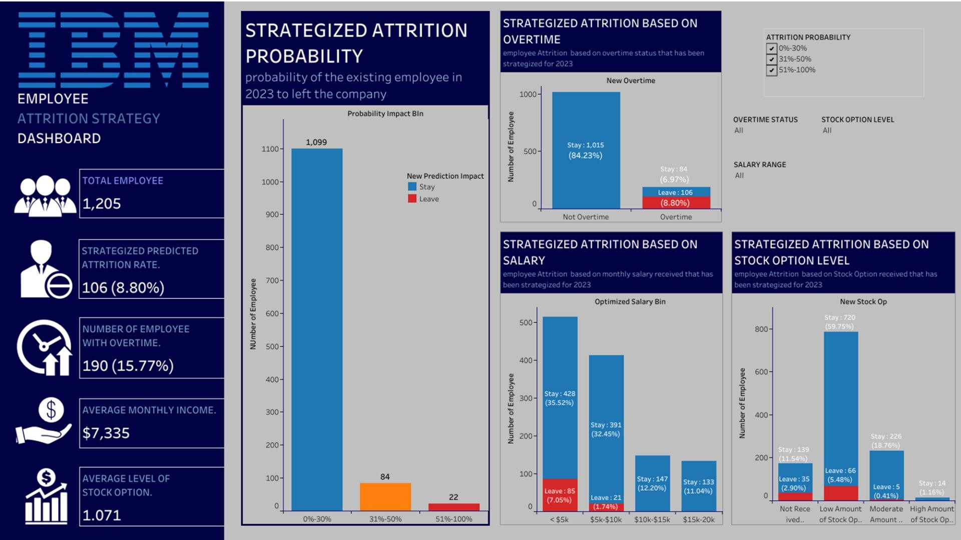

Slide 29
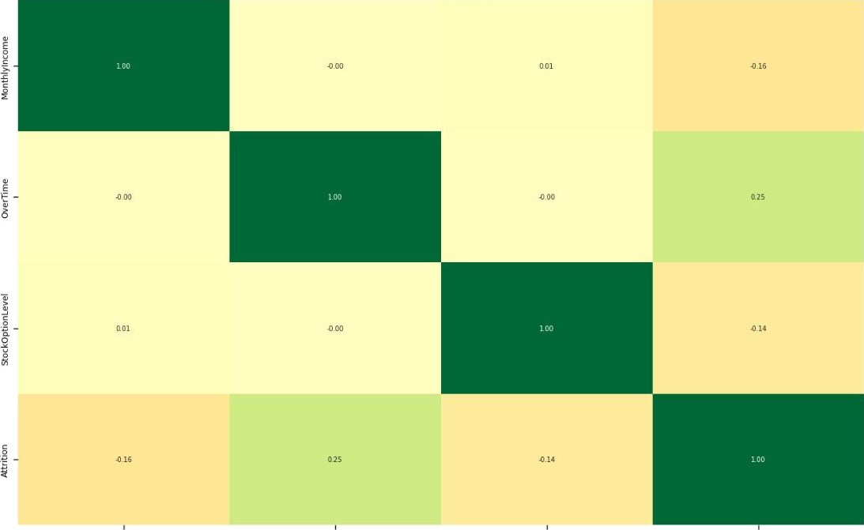
THE VARIABLES' CORRELATION WITH ATTRITION
Heatmap showing the linear correlation coefficients between key numeric employee attributes and attrition
EMPLOYEE ATTRITION
PREDICTION & STRATEGY
2023
29

